Slide 1
Finding Statistics from a Grouped frequency table

Slide 2


We first need to make sure the calculator is CLeaR
of all previous content

Slide 3






We first need to make sure the calculator is CLeaR
of all previous content
3: All
Yes
Reset All

Slide 4





We need to SETUP the calculator to allow us to input
Stat with frequency ON

Slide 5


Statistical and Regression Calculations
Put the calculator into STAT mode

Slide 6










135 145 155 165 175
We only have 1 variable so Select
Enter the number column first pressing
after each one.
(the frequency automatically sets to 1)
Go to the top of the next column
Enter each frequency pressing
After each one
Once they have all been entered press

Slide 8


We now need to analyse the statistics we have input

Slide 9
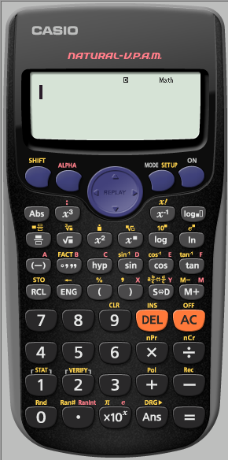




1: Type 2: Data
change the type of data Edit the data
3: Sum 4: Var
1: How many terms
2: Mean of data
5: Min and max of x 3: Population Standard Deviation
4: Sample Standard Deviation
Once you have chosen your required output you need to press

Slide 10











(i) Min
= 135
(ii) Max
= 175
Range
= 175 – 135
= 50
Mean
= 154
Standard Deviation
= 12.74

Slide 11
E.g 1 The frequency table of the monthly salaries of 20 people
is shown below.
a) Calculate the mean of the salaries of the 20 people. b) Calculate the standard deviation of the salaries of the 20
people.
salary(in €) | frequency
3500 | 5
4000 | 8
4200 | 5
4300 | 2

Slide 12
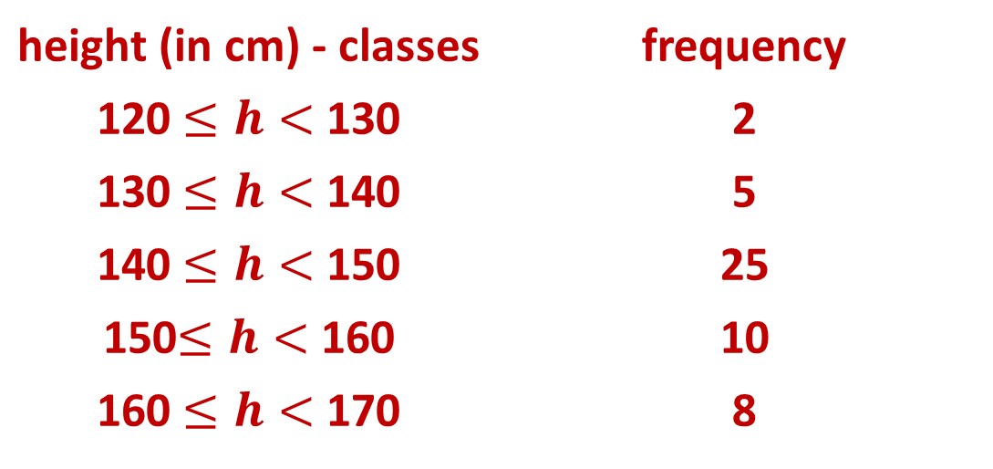
E.g 2. The following table shows the grouped data,
in classes, for the heights of 50 people.
a) Calculate the mean of the salaries of the 20 people. b) Calculate the standard deviation of the salaries of
the 20 people
height (in cm) - classes | frequency
120 $≤h<$ 130 | 2
130 $≤h<$ 140 | 5
140 $≤h<$ 150 | 25
150$≤h<$ 160 | 10
160 $≤h<$ 170 | 8

Slide 13
E.g3. Consider the following three data sets A, B and C. A = {9,10,11,7,13} B = {10,10,10,10,10} C = {1,1,10,19,19} a) Calculate the mean of each data set. b) Calculate the standard deviation of each data set. c) Which set has the largest standard deviation? d) Is it possible to answer question c) without
calculations of the standard deviation?

Slide 14
E.g 4.A given data set has a mean μ and a standard deviation σ. a) What are the new values of the mean and the standard
deviation if the same constant k is added to each data
value in the given set? Explain. b) What are the new values of the mean and the standard
deviation if each data value of the set is multiplied by
the same constant k? Explain.
E.g 5 If the standard deviation of a given data set is equal to
zero, what can we say about the data values included in
the given data set?

